Slide 1
How to Capture a User Tag Using a CSS Selector
Using the EasyTravel Sample Application and Chrome Developer Tools

Slide 2
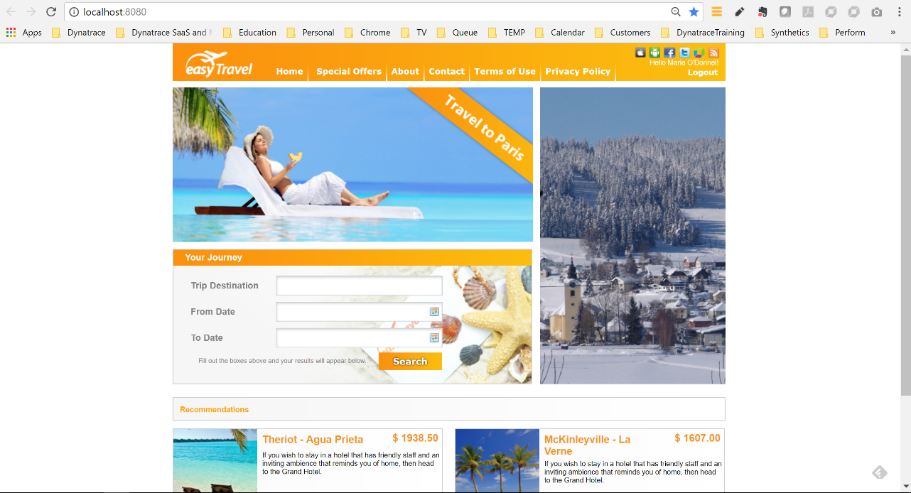
After a login, the user for the EasyTravel sample application is visible on the page, making it an ideal candidate for capture with a CSS Selector.

Slide 3
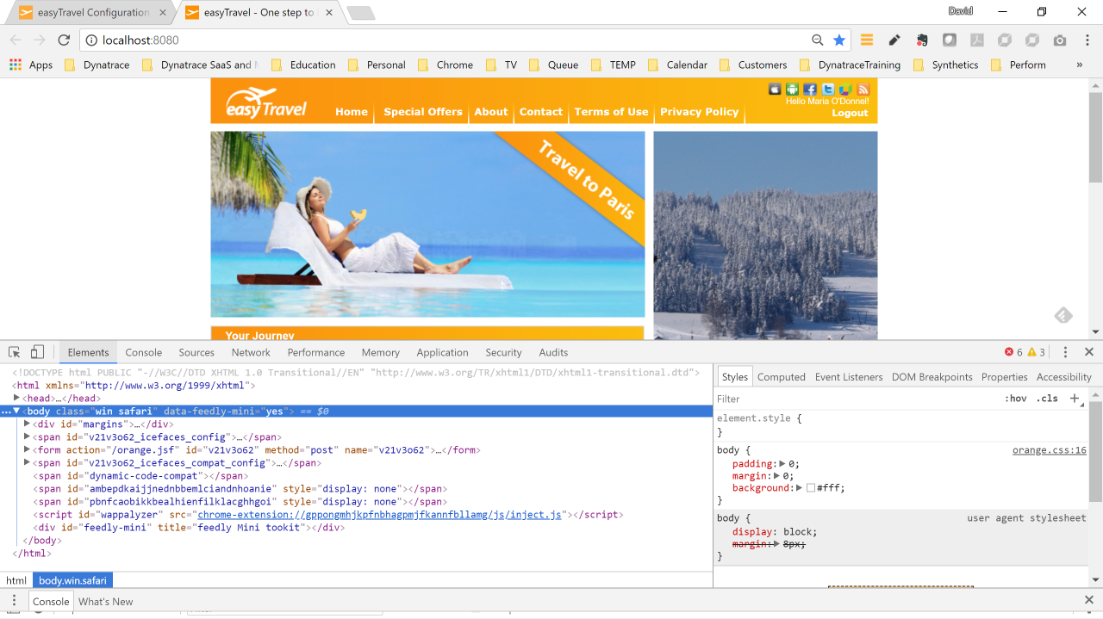
Use F12 to turn on Developer Tools in Chrome, and the bottom pane will display various tabs.

Slide 4
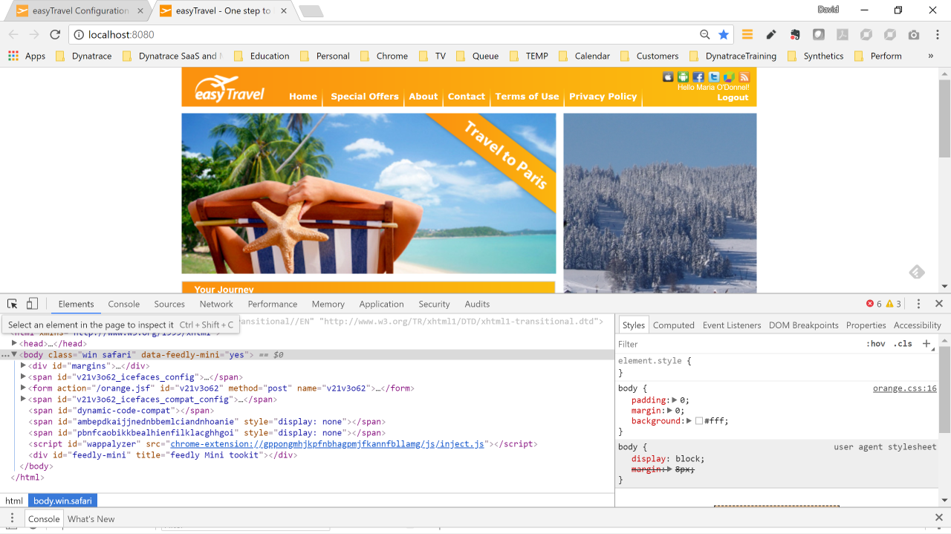
Select the “Elements” tab and then select the pointer icon on the far left.
Select the “Elements” tab and then select the pointer icon on the far left.

Slide 5
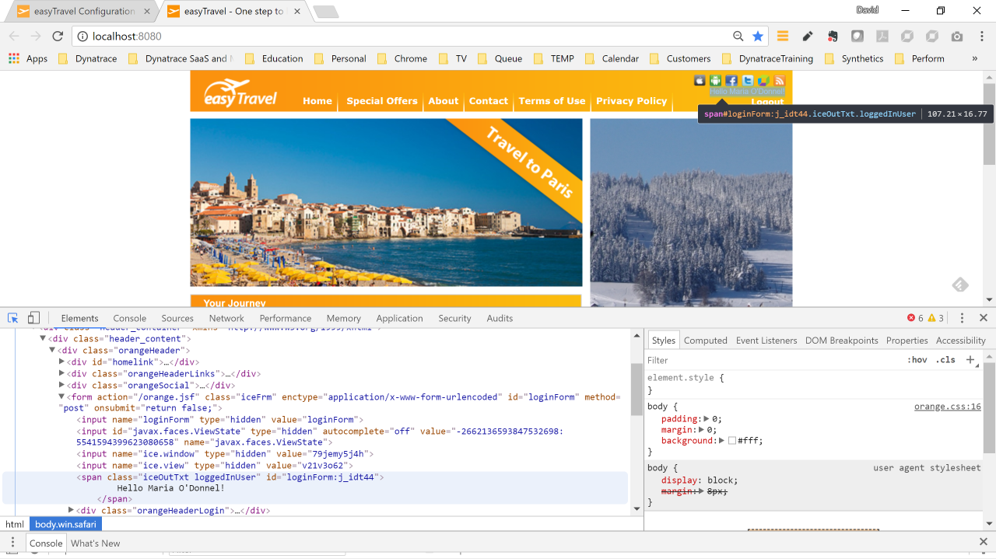
Point to the area containing the desired text, which in this case is the string “Hello Maria O’Donnel!”.

Slide 6
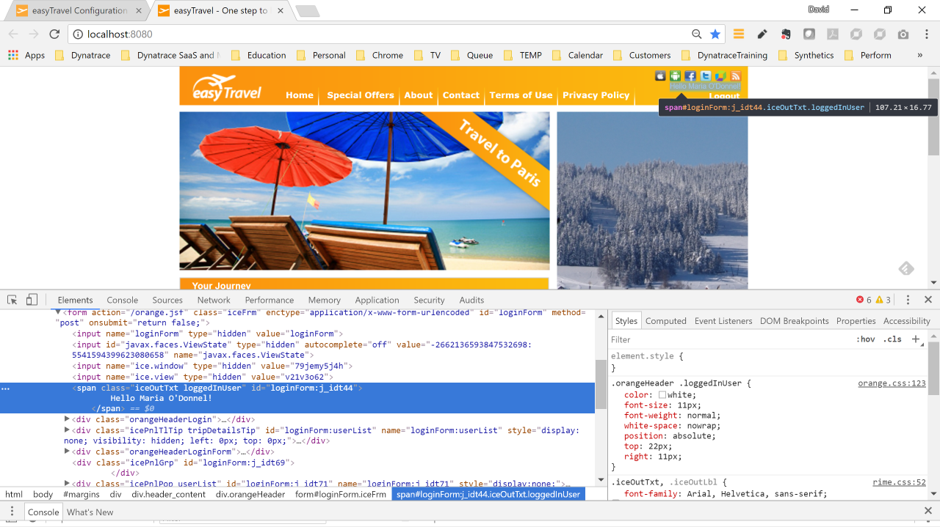
The HTML that controls the display of the selected area will then be highlighted. Note that you can see the desired string within the HTML.

Slide 7
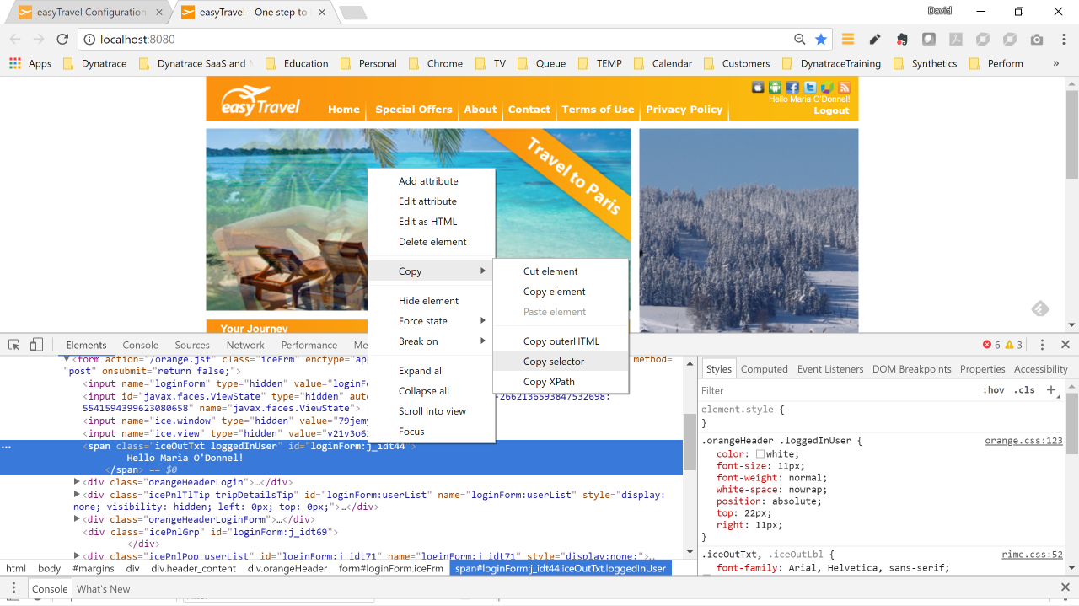
Right click on the highlighted HTML, and choose Copy/Copy selector.

Slide 8
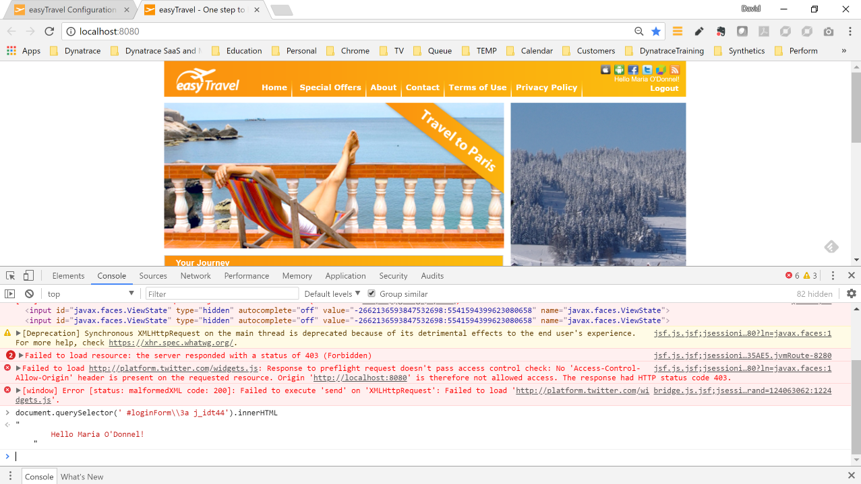
You can test the selector using the “document.querySelector” command by selecting the “Console” tab and entering the command.
Note that you may need to escape a backslash, or other special characters, as was done here with a backslash.
The command used is in this case:
document.querySelector(' #loginForm\\3a j_idt44').innerHTML
(Note the use of the backslash to escape the second backslash)

Slide 9
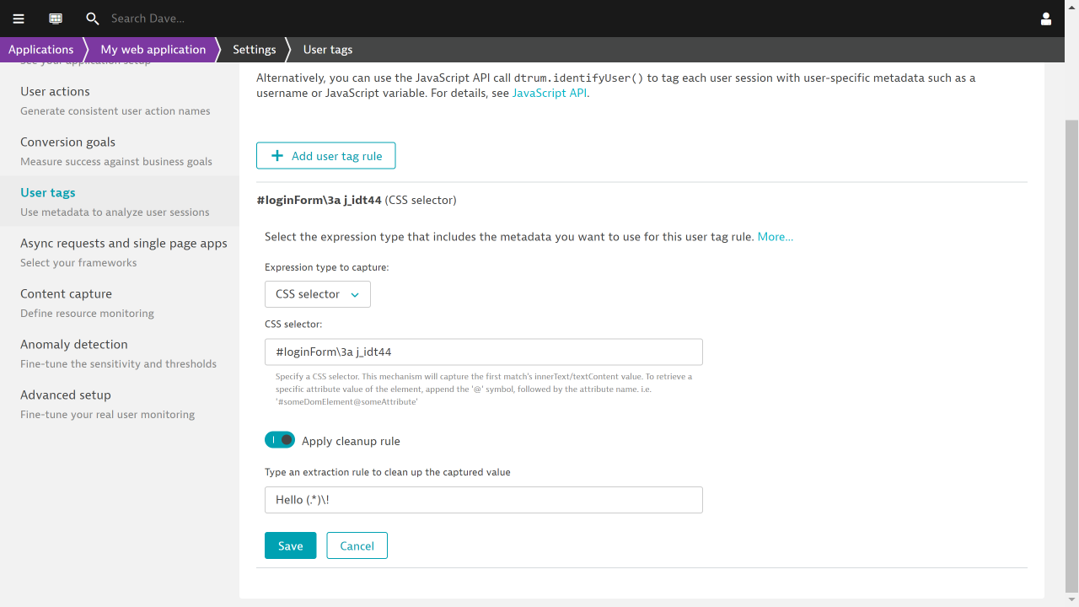
Here is the CSS selector and the extraction rule to remove the “Hello ” prefix and the “!” suffix from the captured string.

Slide 10
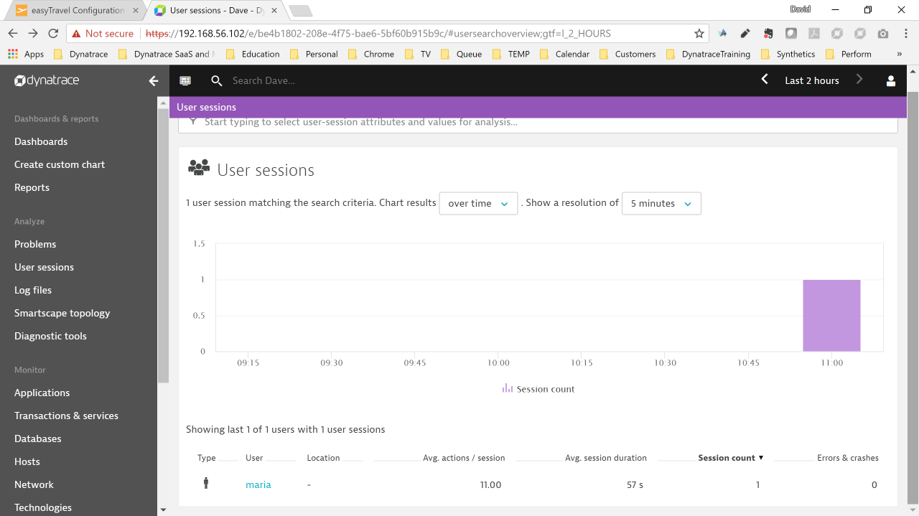
Here is the captured user with the cleanup rule in effect.

